Slide 1
High-Impact Tutoring:
An Evidence-Based Strategy to Accelerate Learning
Office of Educator Effectiveness
Division of Teaching and Learning Services
2024

Slide 2
Agenda
Grounding in Academic Recovery and Response
Overview of High-Impact Tutoring
High-Impact Tutoring Resource Overview
Resources to Support Implementation
NJDOE Supports

Slide 3
Grounding in Academic Recovery and Response

Slide 4
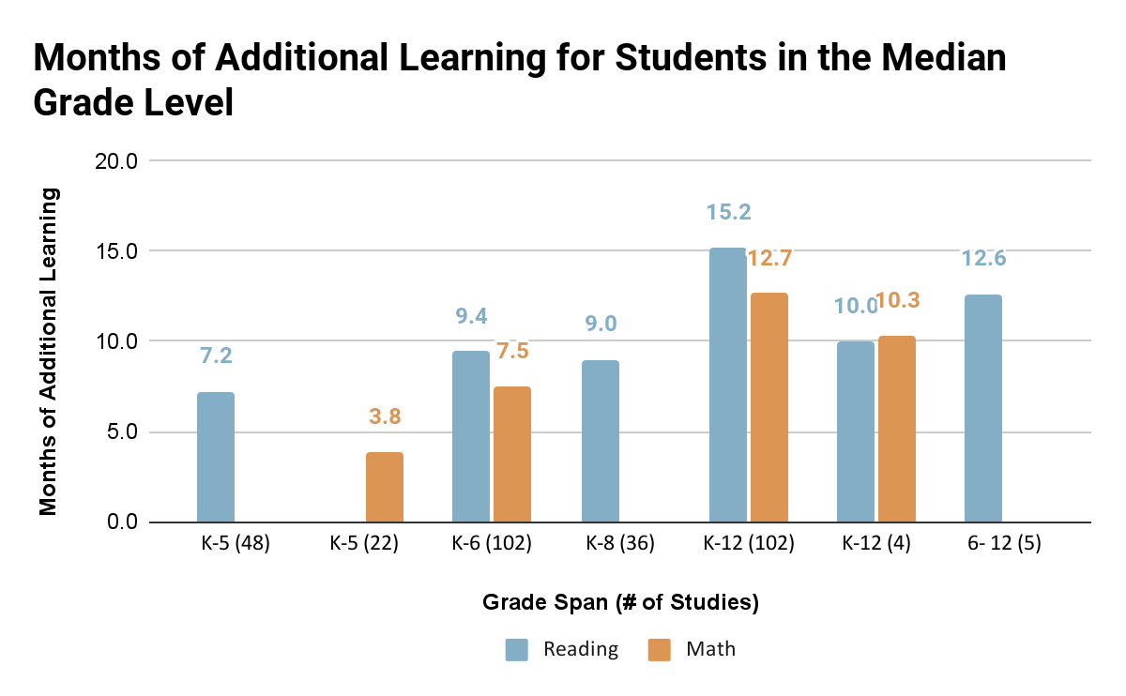
What the Research Says
Eight meta-analyses including over 150 studies consistently find that tutoring results in substantial additional learning for students.
*Source: J-PAL Evidence Review, 2020

Slide 5
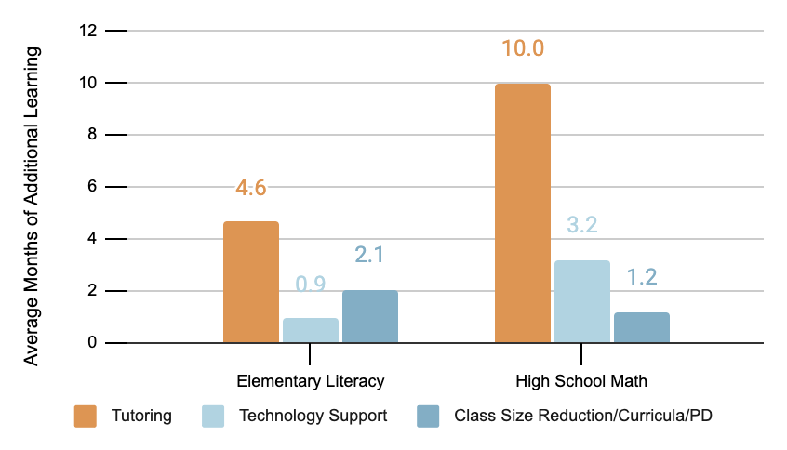
Tutoring to Accelerate Learning
Tutoring is more effective than any other academic intervention.
Research: Substantial effects of high-dosage tutoring delivered in schools
Demand: Already the intervention of choice. US invested ~$42 Billion 2020
Logic: Target students’ needs, builds close relationships
Spillovers: Potential benefits for tutors and for the teacher pipeline
*Source: J-PAL Evidence Review, 2020

Slide 6
High-impact tutoring is one of the most effective ways LEAs can facilitate learning acceleration
High impact tutoring has been proven to:
    Produce large learning gains in a short period of time
    Increase learning for a wide variety of K-12 students
    Be scaled and still improve student learning outcomes
Implementing high impact tutoring is now more feasible than ever before, as tutoring is an explicitly allowable use of ESSER funds
“There is growing consensus that the most promising candidate for successful COVID catchup is [high-impact] tutoring.”
- Mark Schneider, Director of the Institute of Education Sciences

Slide 7
Overview of High-Impact Tutoring

Slide 8
What is High-Impact Tutoring? (1)
High-impact tutoring (often referred to as high-dosage tutoring or tutoring to accelerate learning) is a form of teaching, one-on-one or in a small group, towards a specific goal.
High-impact tutoring leads to substantial learning gains for students by supplementing (but not replacing) students’ classroom experiences.
*Source: Robinson, Carly D., and Susanna Loeb, (2021)

Slide 9
What is High-Impact Tutoring? (2)
High-impact tutoring responds to individual needs and complements students’ existing curriculum.
High-impact tutoring is not remedial work.

Slide 10
What is High-Impact Tutoring? (3)​
High-impact tutoring IS | High-impact tutoring is NOT
Accessible to all | Remedial
Intensive and at least three times per week | Low-dosage or inconsistent
Provided by a qualified tutor | Provided by an unqualified tutor
Individualized | Decontextualized
Responsive | A replacement to core instruction
Figure contents adapted from: Robinson, C.D., Kraft, M.A., Loeb, S., & Schueler, B.E., 2021

Slide 11
Not All Tutoring is Equitable or Effective (1)
No Child Left Behind (NCLB) Supplementary Educational Services (SES)
  Federally funded program that allowed parents to opt-in if school struggled for 2+ years
  Low participation
  Little impact on student learning
  The instances where SES positively impacted student learning tended to involve minimum dosage environment, structured sessions, tutor coordination with schools and more tutor experience.
  *Source: Heinrich et al., 2014

Slide 12
Not All Tutoring is Equitable or Effective (2)
Opt-in/On-Demand Tutoring Research Implications for Practice
  Opt-in educational resources (like on demand tutoring) are unlikely to accelerate student learning at scale and mitigate inequality;
  Targeting communications to parents and students together can increase engagement with opt-in tutoring; and
  Supporting students who are struggling will require a coordinated effort between educators, families, and students to provide students with embedded personalized learning opportunities.
  .
  *Source: National Student Support Accelerator, 2022

Slide 13
Effective Tutoring Programs
High-dosage (i.e., three or more sessions per week ),
Focused on cultivating tutor-student relationships,
Use of formative assessments to monitor student learning,
Alignment with the school curriculum, and
Formalized tutor training and support.
*Source J-PAL Evidence Review, 2020

Slide 14
High-Impact Tutoring Resource Overview

Slide 15
High-Impact Tutoring Resource Overview
This resource is designed to help local education agencies (LEAs), interested in high-impact tutoring to meet students' needs, think through key pieces of program design and implementation and make connections to other helpful resources.

Slide 16
High-Impact Tutoring Design Elements
High-impact tutoring design elements are grounded in equity, safety and cohesion.

Slide 17
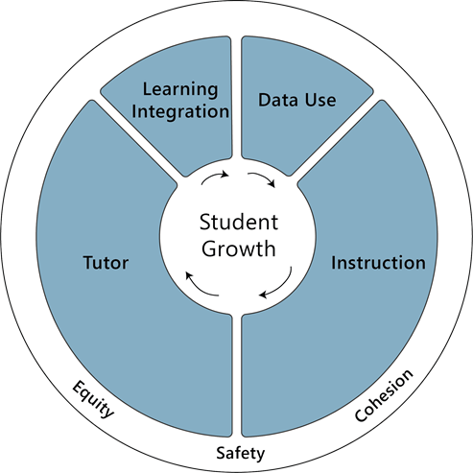
High-Impact Tutoring Design Elements
A well-trained consistent tutor;
High-quality instructional materials;
One-to-one or small groups;
Embedded in the school day or immediately before or after school;
At least three sessions per week; and
Data driven.
*Source: Kraft, Matthew A., and Grace T. Falken, 2021
Notes:
When designing an effective, high-quality tutoring, there are several design elements to consider.
College students, paras

Slide 18
Resources to Support Implementation

Slide 19
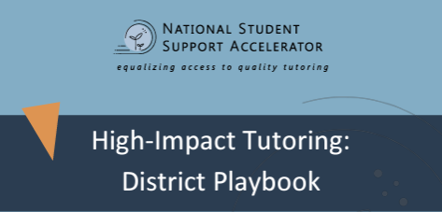
The National Student Support Accelerator Tools
High-impact Tutoring District Playbook
Toolkit for Tutoring Program
Tutoring Cost Calculator
Searchable Tutoring Database
Early Literacy Tutoring Toolkit
Tutoring Quality Improvement System (TQIS)

Slide 20
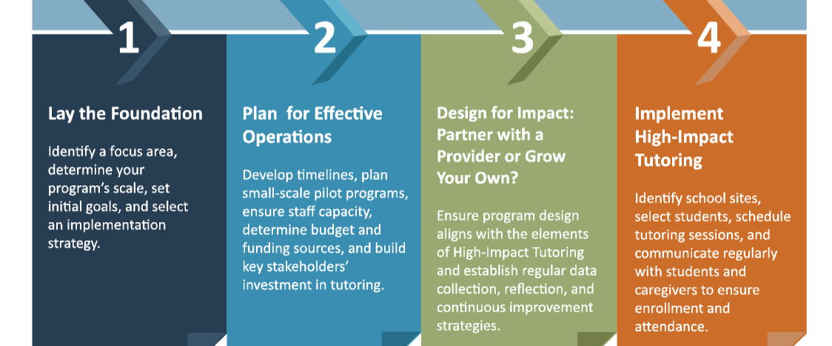
Developing and Implementing High-Impact Tutoring
*Source: National Student Support Accelerator, (2021)

Slide 21
1. Lay the Foundation
Key Activities
Assemble an inclusive task force;
Plan for alignment of tutoring with existing initiatives; and
Set the academic, social and emotional goals for programmatic goals as well.
Resources
Toolkit for Tutoring Programs
Conducting a Community Landscape Analysis

Slide 22
2. Plan for Effective Operations
Key Activities
Develop share a reasonable timeline;
Develop an inclusive budget and identified initial and sustainable funding sources; and
Continue building stakeholder investment and incorporating stakeholders in the planning and decision-making process.
Resources
Tutoring Cost Calculator
High-Impact Tutoring: District Playbook

Slide 23
3. Design for Impact
Key Activities
Determine whether to partner with a high-quality tutoring provider or grow your own program;
Develop systems and processes for data collection, reflection, and continuous improvement; and
Develop a plan for regularly and clearly communicating with stakeholders.
Resources
Recruitment and Selection
Measures & Data Collection
Actions and Practices Reflection Tool

Slide 24
Partner or Grow Your Own
If you partner:
    Select and contract with a partner(s)
    Adopt partner’s model to your LEA’s needs
If you grow your own:
    Design a program model based on best practices
    Recruit and train tutors

Slide 25
4. Implement High-Impact Tutoring
Key Activities
Develop guidelines for selecting school sites and specific individual students for tutoring;
Implement school site logistics; and
Plan regular communication with caregivers and students to ensure enrollment and attendance.
Resources
Program Implementation Tools
Stakeholder Engagement
Tool Appendix

Slide 26
NJDOE Supports

Slide 27
LEA Supports
Maximizing Schedules to Support Learning Acceleration Resource ​
Summer Planning and Programming Resource​
High-Impact Tutoring Design and Implementation Supports​
Grade-Level Content Resource​
High-Impact Tutoring Pre-approved List

Slide 28
We’re here to help!
Please contact us with any questions. We have a dedicated communication stream to empower and enable success around high-impact tutoring work.
Email: NJTutor@doe.nj.gov

Slide 29
Thank You!
New Jersey Department of Education: nj.gov/education
Office of Educator Effectiveness
Follow Us!
Facebook:
@njdeptofed
Twitter: @NewJerseyDOE
Instagram:
@NewJerseyDoe

